Slide 1
Grasshopper Optimization Algorithm for 01 Knapsack Problem

Slide 2
Dataset
Maximum weight: 26
Item | 1 | 2 | 3 | 4 | 5
Weight | 12 | 7 | 11 | 8 | 9
Profits | 24 | 13 | 23 | 8 | 9
Generate random data:
Item | 1 | 2 | 3 | 4 | 5
1 | 0 | 1 | 0 | 1 | 1
2 | 1 | 0 | 0 | 1 | 0
3 | 1 | 1 | 0 | 0 | 1

Slide 3
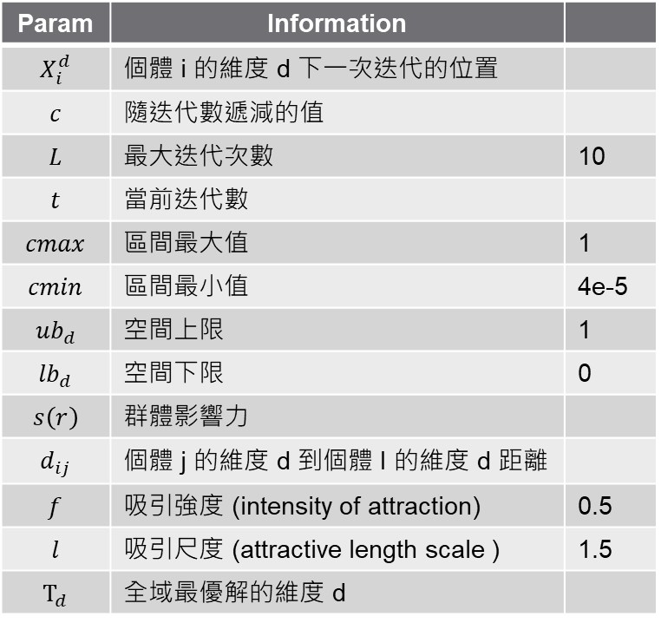

Formula
Param | Information
$$X_{i}^{d}$$ | 個體 i 的維度 d 下一次迭代的位置
$$c$$ | 隨迭代數遞減的值
$$L$$ | 最大迭代次數 | 10
$$t$$ | 當前迭代數
$$cmax$$ | 區間最大值 | 1
$$cmin$$ | 區間最小值 | 4e-5
$${ub}_{d}$$ | 空間上限 | 1
$${lb}_{d}$$ | 空間下限 | 0
$$s\left(r\right)$$ | 群體影響力
$$d_{ij}$$ | 個體 j 的維度 d 到個體 I 的維度 d 距離
$$f$$ | 吸引強度 (intensity of attraction) | 0.5
$$l$$ | 吸引尺度 (attractive length scale ) | 1.5
$$T_{d}$$ | 全域最優解的維度 d
$X_{i}^{d}=c\left(\sum_{j=1, j≠i}^{N}{c\frac{{ub}_{d}−{lb}_{d}}{2}×s\left(d_{ij}\right)×}\frac{x_{j}−x_{i}}{d_{ij}}\right)+T_{d}$
$c=cmax−t\frac{cmax−cmin}{L}$
$s\left(r\right)=fe^{\frac{−r}{l}}−e^{−r}$
$d_{ij}=\left|x_{j}^{d}−x_{i}^{d}\right|$

Slide 4
Iteration-1
Item | 1 | 2 | 3 | 4 | 5
Weight | 12 | 7 | 11 | 8 | 9
Profits | 24 | 13 | 23 | 8 | 9
Calculate fitness value:
Punish fitness value: 5
Item | 1 | 2 | 3 | 4 | 5 | Weight | Profits
1 | 0 | 1 | 0 | 1 | 1 | 24 | 44
2 | 1 | 0 | 0 | 1 | 0 | 20 | 39
3 | 1 | 1 | 0 | 0 | 1 | 28 | 5
Global optimal:
Item | 1 | 2 | 3 | 4 | 5 | Weight | Profits
1 | 0 | 1 | 0 | 1 | 1 | 24 | 44

Slide 5
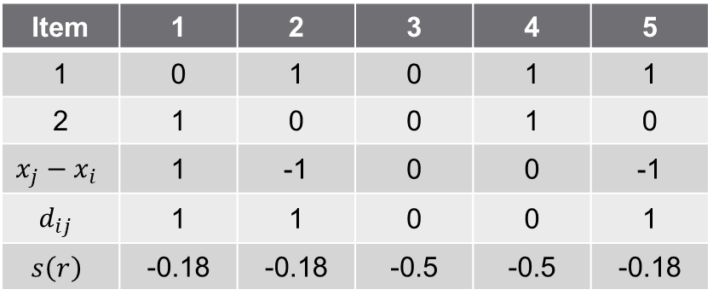
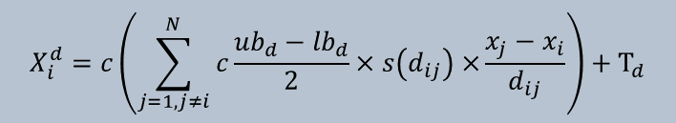
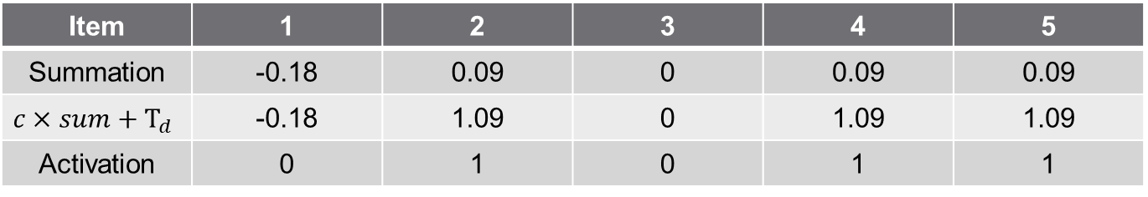
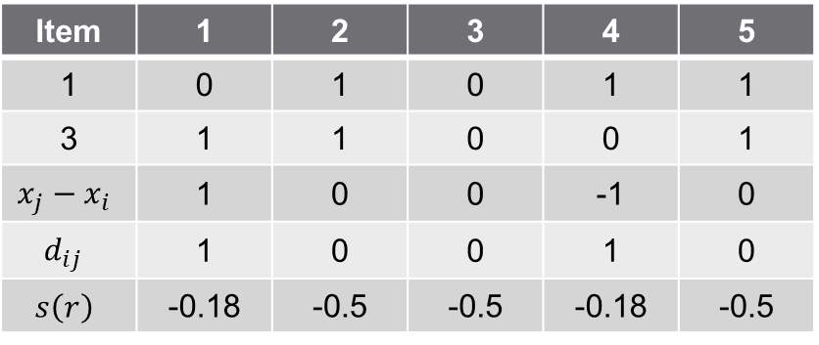
Iteration-1
$$X_{i}^{d}=c\left(\sum_{j=1, j≠i}^{N}{c\frac{{ub}_{d}−{lb}_{d}}{2}×s\left(d_{ij}\right)×}\frac{x_{j}−x_{i}}{d_{ij}}\right)+T_{d}$$
Item | 1 | 2 | 3 | 4 | 5
1 | 0 | 1 | 0 | 1 | 1
2 | 1 | 0 | 0 | 1 | 0
3 | 1 | 1 | 0 | 0 | 1
i=1, j=2
i=1, j=3
Item | 1 | 2 | 3 | 4 | 5
1 | 0 | 1 | 0 | 1 | 1
2 | 1 | 0 | 0 | 1 | 0
$$x_{j}−x_{i}$$ | 1 | -1 | 0 | 0 | -1
$$d_{ij}$$ | 1 | 1 | 0 | 0 | 1
$$s\left(r\right)$$ | -0.18 | -0.18 | -0.5 | -0.5 | -0.18
Item | 1 | 2 | 3 | 4 | 5
1 | 0 | 1 | 0 | 1 | 1
3 | 1 | 1 | 0 | 0 | 1
$$x_{j}−x_{i}$$ | 1 | 0 | 0 | -1 | 0
$$d_{ij}$$ | 1 | 0 | 0 | 1 | 0
$$s\left(r\right)$$ | -0.18 | -0.5 | -0.5 | -0.18 | -0.5
if result > 0.5:
result = 1
else:
result = 0
Item | 1 | 2 | 3 | 4 | 5
Summation | -0.18 | 0.09 | 0 | 0.09 | 0.09
$$c×sum+T_{d}$$ | -0.18 | 1.09 | 0 | 1.09 | 1.09
Activation | 0 | 1 | 0 | 1 | 1
X₁

Slide 6
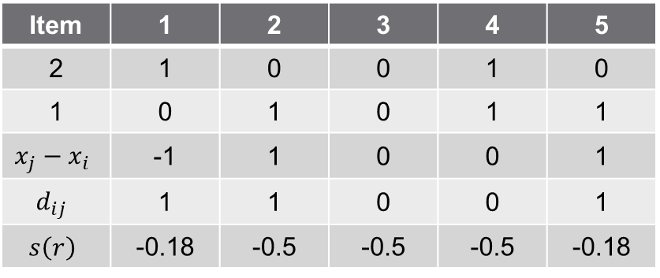

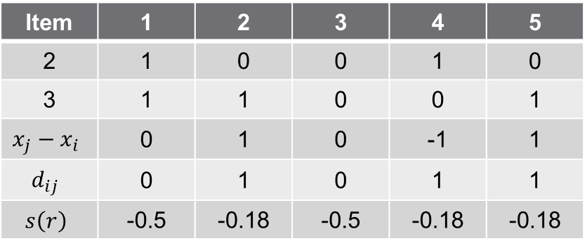
Iteration-1
$$X_{i}^{d}=c\left(\sum_{j=1, j≠i}^{N}{c\frac{{ub}_{d}−{lb}_{d}}{2}×s\left(d_{ij}\right)×}\frac{x_{j}−x_{i}}{d_{ij}}\right)+T_{d}$$
Item | 1 | 2 | 3 | 4 | 5
1 | 0 | 1 | 0 | 1 | 1
2 | 1 | 0 | 0 | 1 | 0
3 | 1 | 1 | 0 | 0 | 1
i=2, j=1
i=2, j=3
Item | 1 | 2 | 3 | 4 | 5
2 | 1 | 0 | 0 | 1 | 0
1 | 0 | 1 | 0 | 1 | 1
$$x_{j}−x_{i}$$ | -1 | 1 | 0 | 0 | 1
$$d_{ij}$$ | 1 | 1 | 0 | 0 | 1
$$s\left(r\right)$$ | -0.18 | -0.5 | -0.5 | -0.5 | -0.18
Item | 1 | 2 | 3 | 4 | 5
2 | 1 | 0 | 0 | 1 | 0
3 | 1 | 1 | 0 | 0 | 1
$$x_{j}−x_{i}$$ | 0 | 1 | 0 | -1 | 1
$$d_{ij}$$ | 0 | 1 | 0 | 1 | 1
$$s\left(r\right)$$ | -0.5 | -0.18 | -0.5 | -0.18 | -0.18
if result > 0.5:
result = 1
else:
result = 0
Item | 1 | 2 | 3 | 4 | 5
Summation | 0.09 | -0.18 | 0 | 0.09 | -0.18
$$c×sum+T_{d}$$ | 0.09 | 0.81 | 0 | 1.09 | 0.81
Activation | 0 | 1 | 0 | 1 | 1
X₂

Slide 7
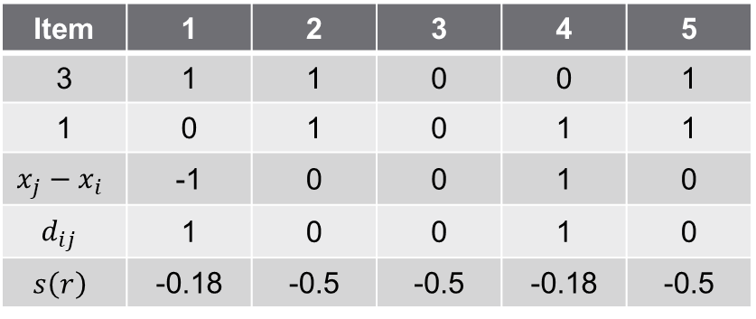
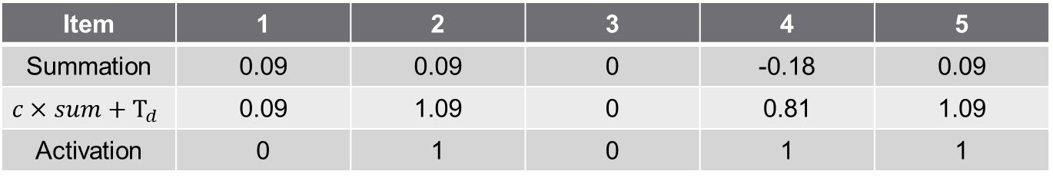
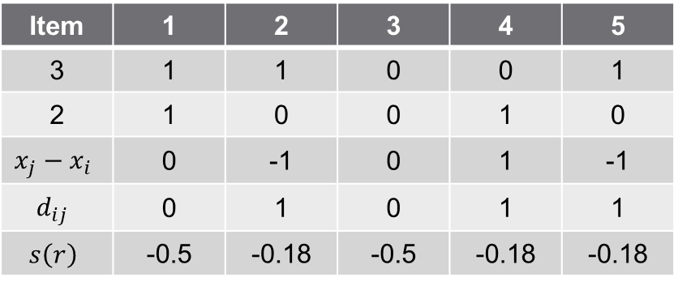
Iteration-1
$$X_{i}^{d}=c\left(\sum_{j=1, j≠i}^{N}{c\frac{{ub}_{d}−{lb}_{d}}{2}×s\left(d_{ij}\right)×}\frac{x_{j}−x_{i}}{d_{ij}}\right)+T_{d}$$
Item | 1 | 2 | 3 | 4 | 5
1 | 0 | 1 | 0 | 1 | 1
2 | 1 | 0 | 0 | 1 | 0
3 | 1 | 1 | 0 | 0 | 1
i=3, j=1
i=3, j=2
Item | 1 | 2 | 3 | 4 | 5
3 | 1 | 1 | 0 | 0 | 1
1 | 0 | 1 | 0 | 1 | 1
$$x_{j}−x_{i}$$ | -1 | 0 | 0 | 1 | 0
$$d_{ij}$$ | 1 | 0 | 0 | 1 | 0
$$s\left(r\right)$$ | -0.18 | -0.5 | -0.5 | -0.18 | -0.5
Item | 1 | 2 | 3 | 4 | 5
3 | 1 | 1 | 0 | 0 | 1
2 | 1 | 0 | 0 | 1 | 0
$$x_{j}−x_{i}$$ | 0 | -1 | 0 | 1 | -1
$$d_{ij}$$ | 0 | 1 | 0 | 1 | 1
$$s\left(r\right)$$ | -0.5 | -0.18 | -0.5 | -0.18 | -0.18
if result > 0.5:
result = 1
else:
result = 0
Item | 1 | 2 | 3 | 4 | 5
Summation | 0.09 | 0.09 | 0 | -0.18 | 0.09
$$c×sum+T_{d}$$ | 0.09 | 1.09 | 0 | 0.81 | 1.09
Activation | 0 | 1 | 0 | 1 | 1
X₃

Slide 8
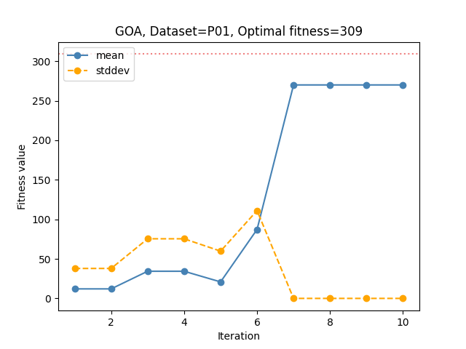
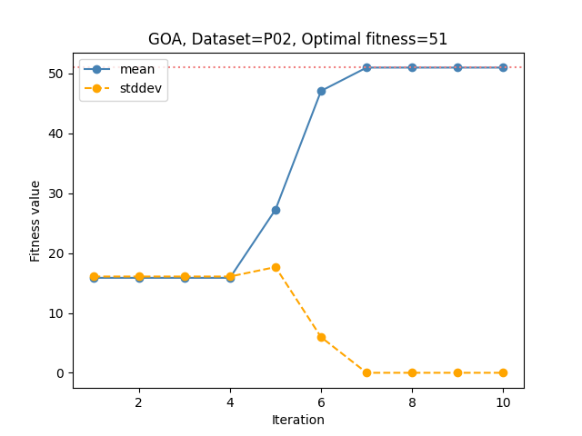
Figure
Dataset: P01
Dataset: P02

